Slide 1

DocSense: Semantic Document QA using RAG
Group 14
Sriyashveer Reddy Pulapalli
Sai Varun Chetrypally
Rishitha Challa
Youngstown State University
Faculty Coach
Dr. Feng George Y
CSCI 6991 Data Engineering Capstone

Slide 2
Introduction
Large documents are hard to search manually
Keyword search lacks semantic understanding
Need intelligent document querying system
CSCI 6991 Data Engineering Capstone

Slide 3
Background
Embeddings: Convert text into numerical vectors
Vector Databases: Store and search embeddings efficiently
Semantic Search: Finds meaning, not exact words
RAG (Retrieval-Augmented Generation):
Retrieval → find relevant text
Generation → produce final answer
CSCI 6991 Data Engineering Capstone

Slide 4
Problem Statement
Extracting insights from PDFs is difficult
Keyword search fails with different phrasing
Need scalable QA system
CSCI 6991 Data Engineering Capstone

Slide 5
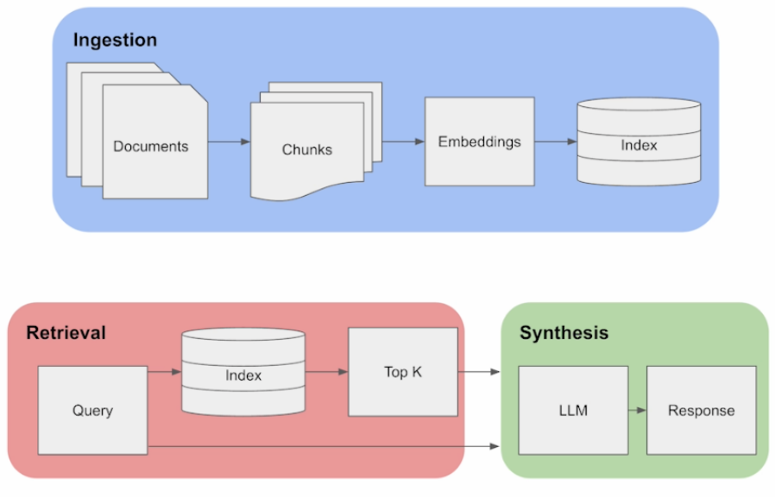
Methodology
Basic RAG Pipeline
CSCI 6991 Data Engineering Capstone

Slide 6
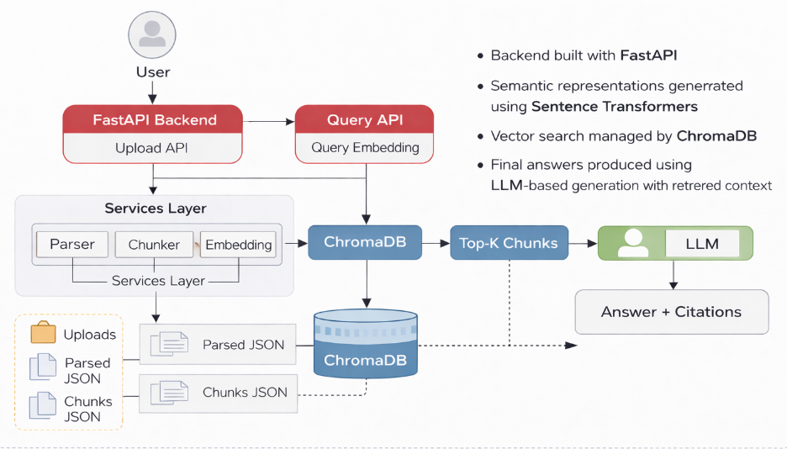
System Architecture
CSCI 6991 Data Engineering Capstone

Slide 7
Experiments
Tested system using multiple PDF documents of varying size and content
Evaluated semantic retrieval using different queries
Compared performance using different top_k values (2, 3, 5)
Measured relevance of retrieved chunks based on query intent
CSCI 6991 Data Engineering Capstone

Slide 8
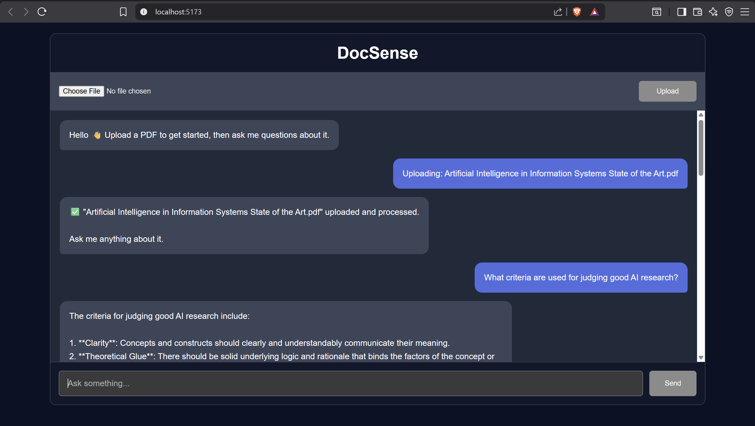
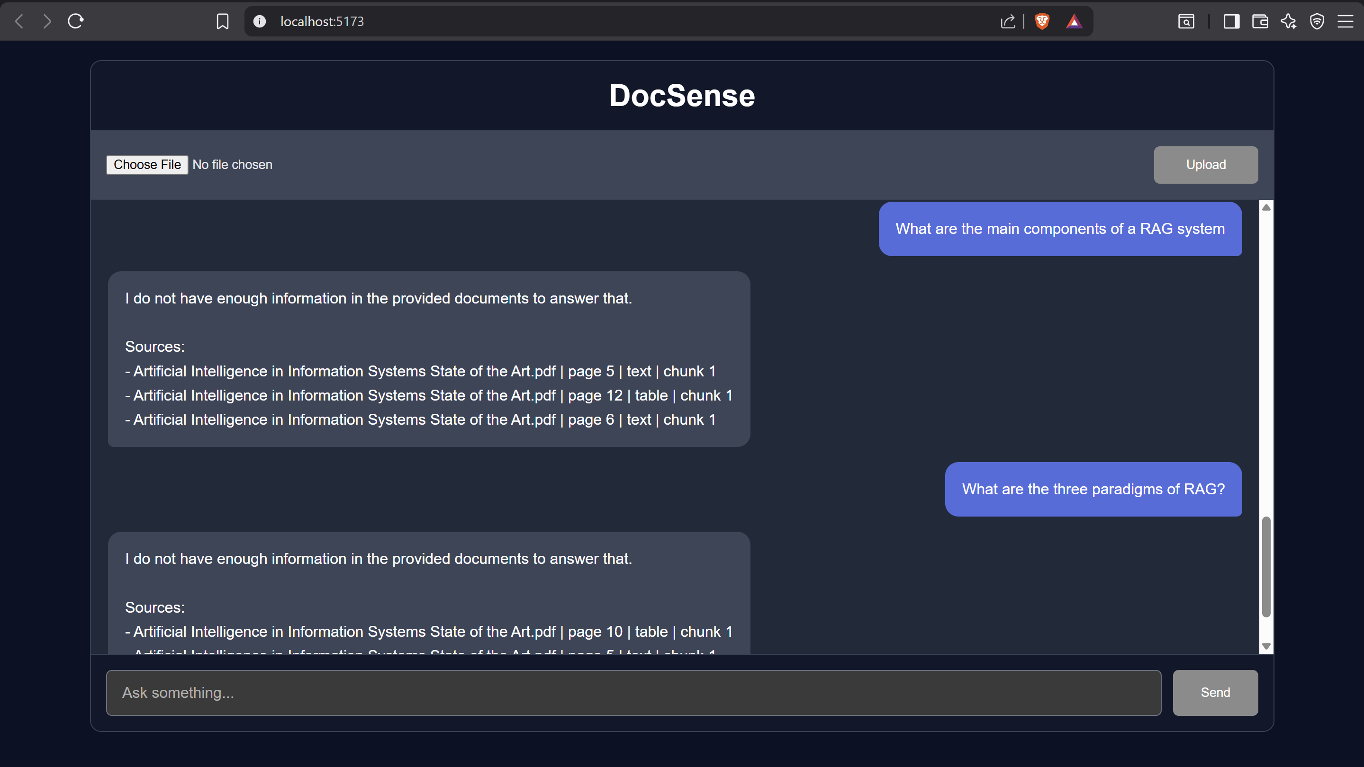
Results
System successfully retrieves semantically relevant information
Performs better than traditional keyword-based search
Handles variation in query phrasing effectively
CSCI 6991 Data Engineering Capstone

Slide 9
Limitations
Retrieval quality depends on chunk size
Requires tuning of top_k parameter
LLM responses depend on retrieved context
Future works
Enable multi-PDF upload and cross-document querying
Improve retrieval with dynamic chunking and fine-tuned embeddings
Add user feedback system to enhance answer quality
CSCI 6991 Data Engineering Capstone

Slide 10
Conclusion
Developed a complete RAG-based document QA system
Enables natural language interaction with documents
Demonstrates effectiveness of semantic search and vector databases
Scalable and extensible for real-world applications
CSCI 6991 Data Engineering Capstone

Slide 11
Team Contributions
Sriyashveer Reddy Pulapalli – Backend & API Development
Sai Varun Chetrypally – Parsing & Embedding Pipeline
Rishitha Challa – Vector Database & Retrieval System
All members contributed to system integration, testing, and debugging
CSCI 6991 Data Engineering Capstone

Slide 12
GitHub Repository
GitHub Repository: https://github.com/Varunch-16/docsense
Includes:
Source code
Documentation
Test queries and sample outputs

